Slide 1
NBA Basketball Analysis
“Who’s Gonna Win?”
Wen Lin

Slide 2

What happened? COVID-19
Why?
Who? John Hollinger
How? The work is REAL
Summary

Slide 3
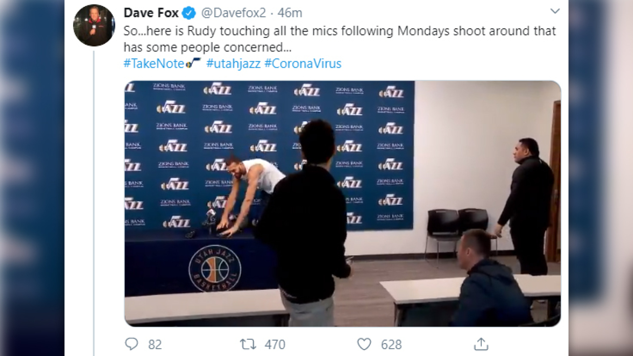
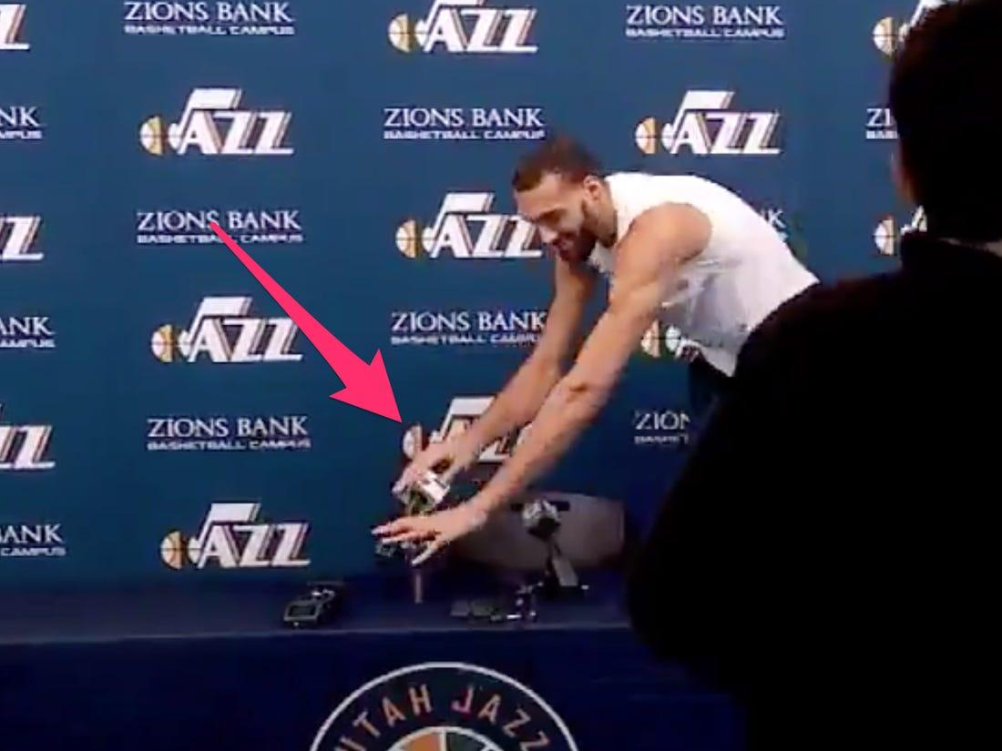
Notes:
Earlier this year on March 9th, Rudy Gobert, Center for the Utah Jazz, was asked about the corona-virus at the pregame press conference.
In response, he jokingly touched all the recording equipments around him before leaving his press duties.

Slide 4
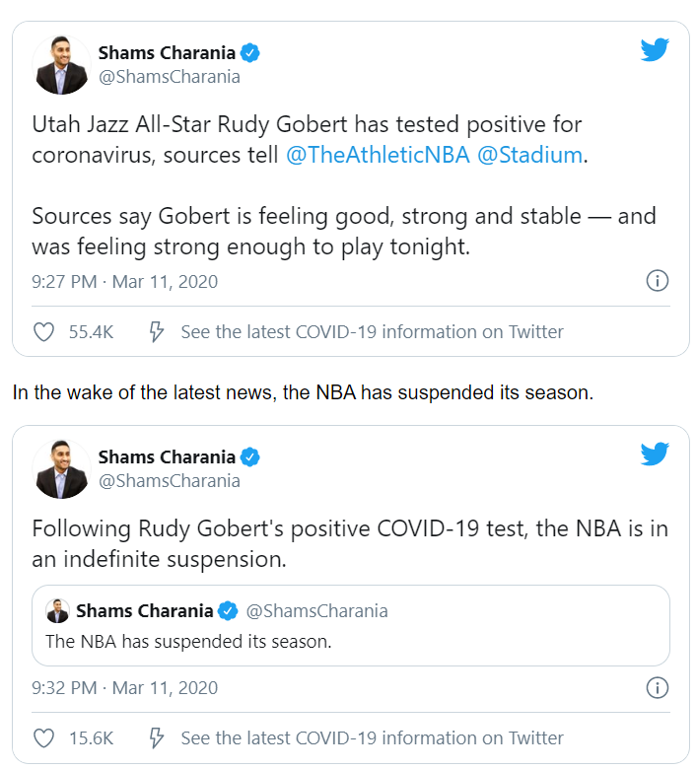
Notes:
Just 2 days later, Rudy Gobert tested positive for coronavirus, and the entire 2019-2020 season was put on hold because of the uncertainties created by covid19.

Slide 5
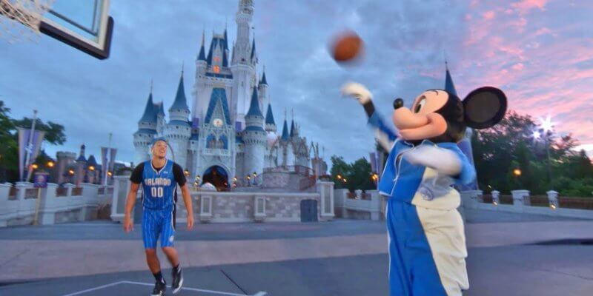
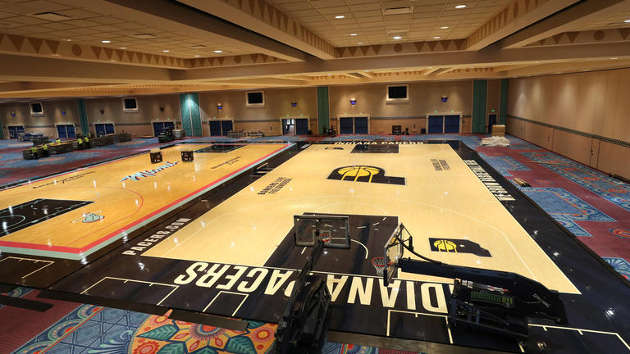
The NBA is now ready to return on July 30th in Orlando:
All 22 qualified teams will play the remaining 8 regular season games,
and then begin the 16-teams playoff tournament.

Slide 6
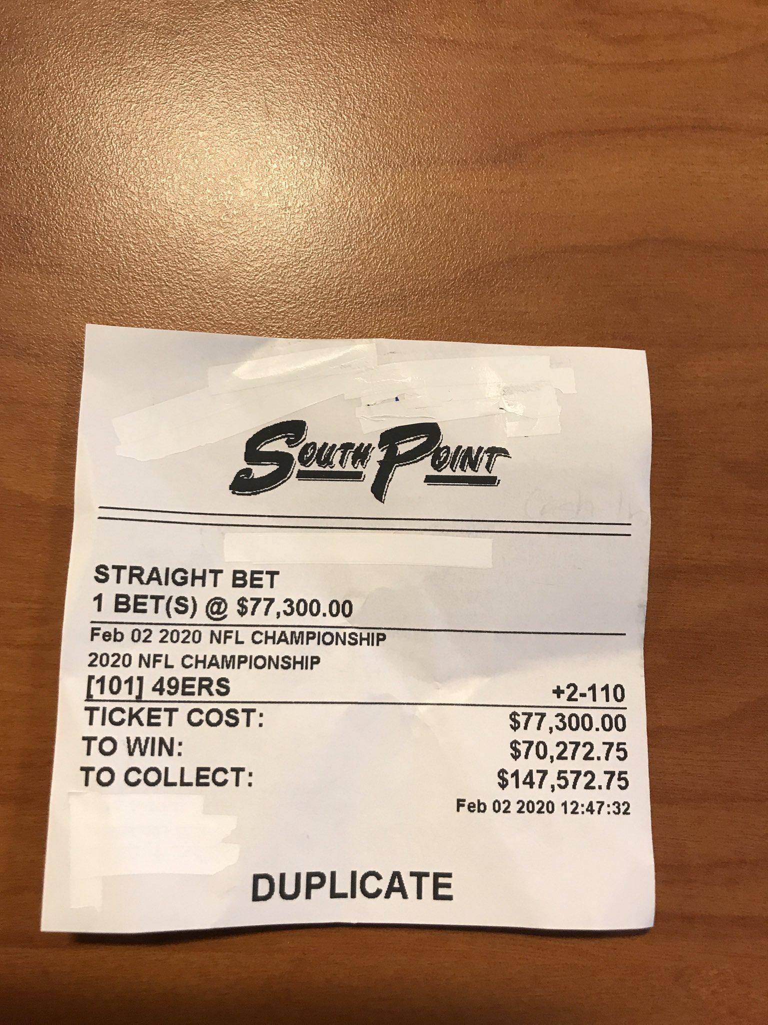
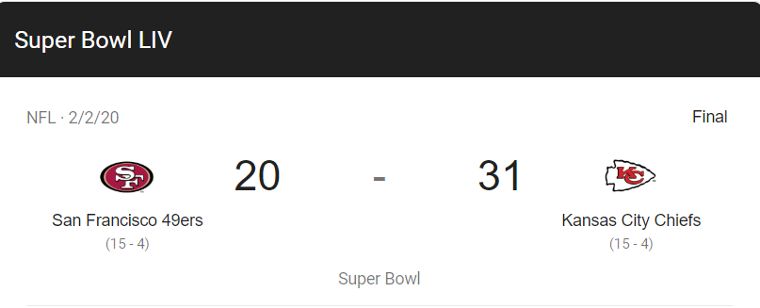
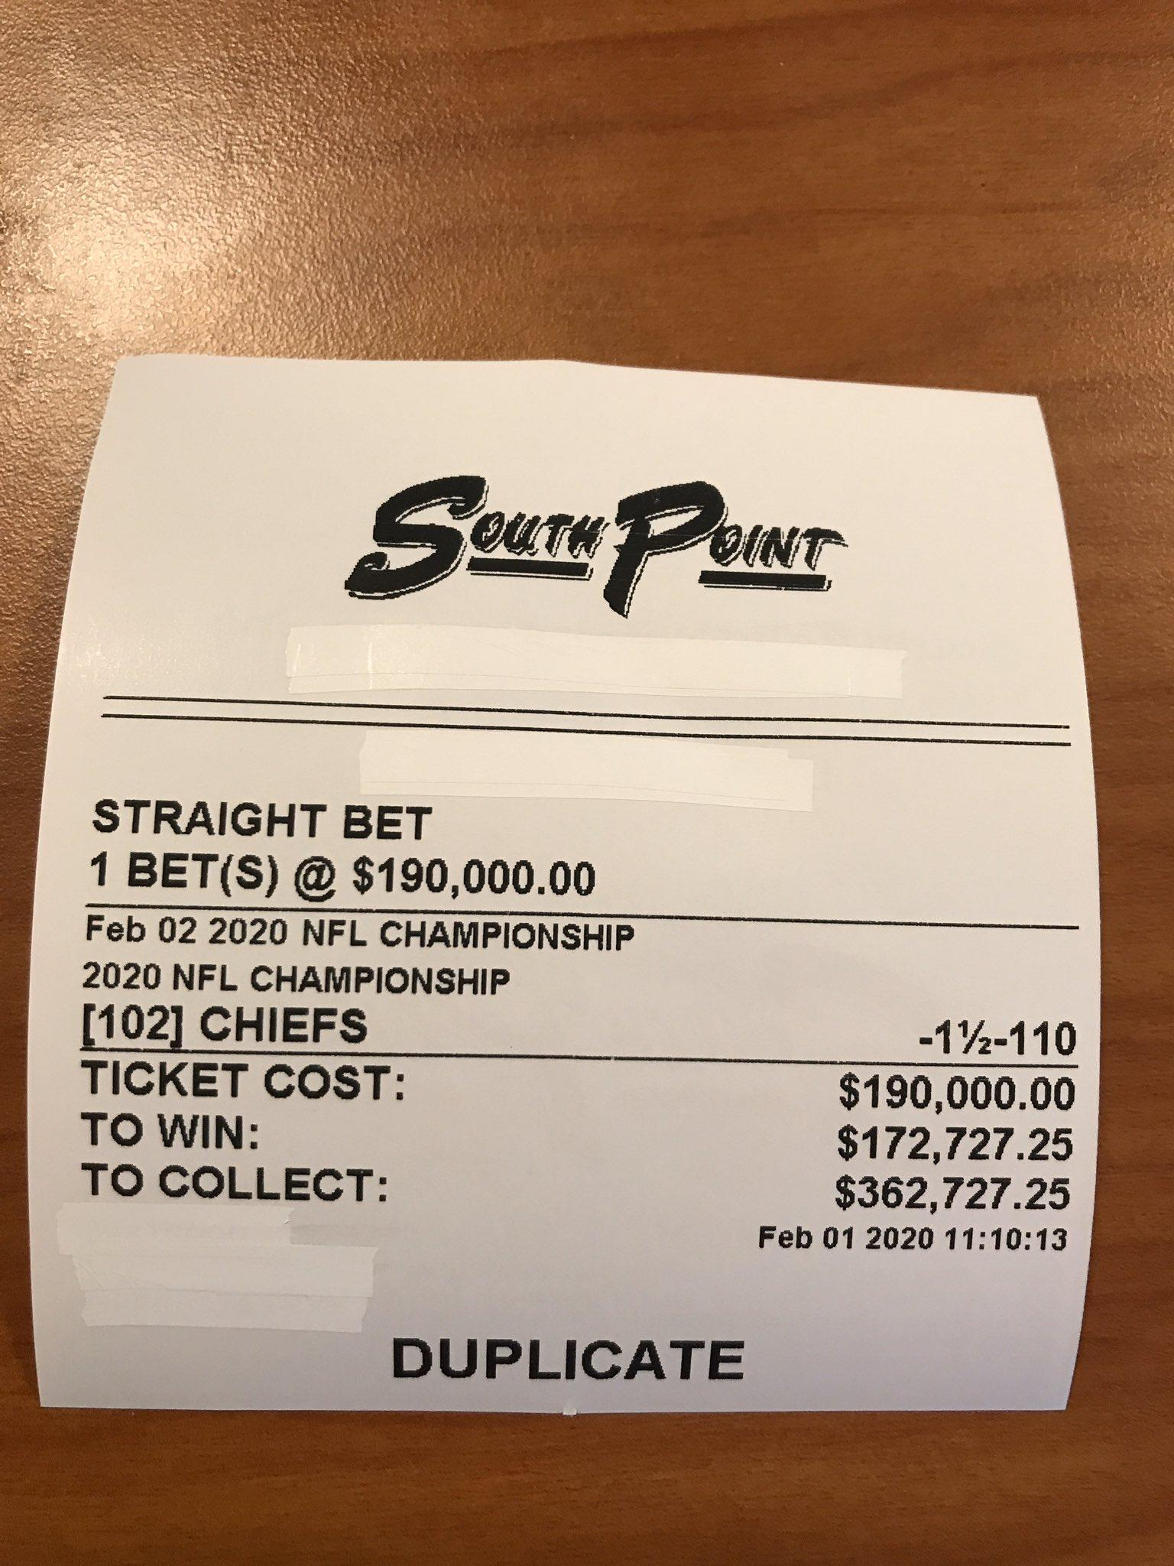
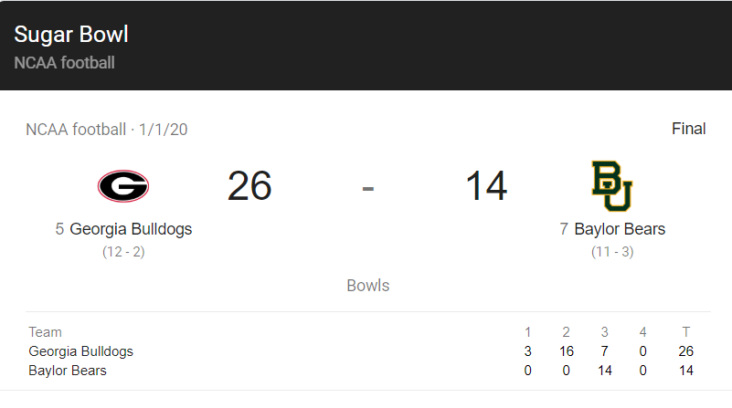
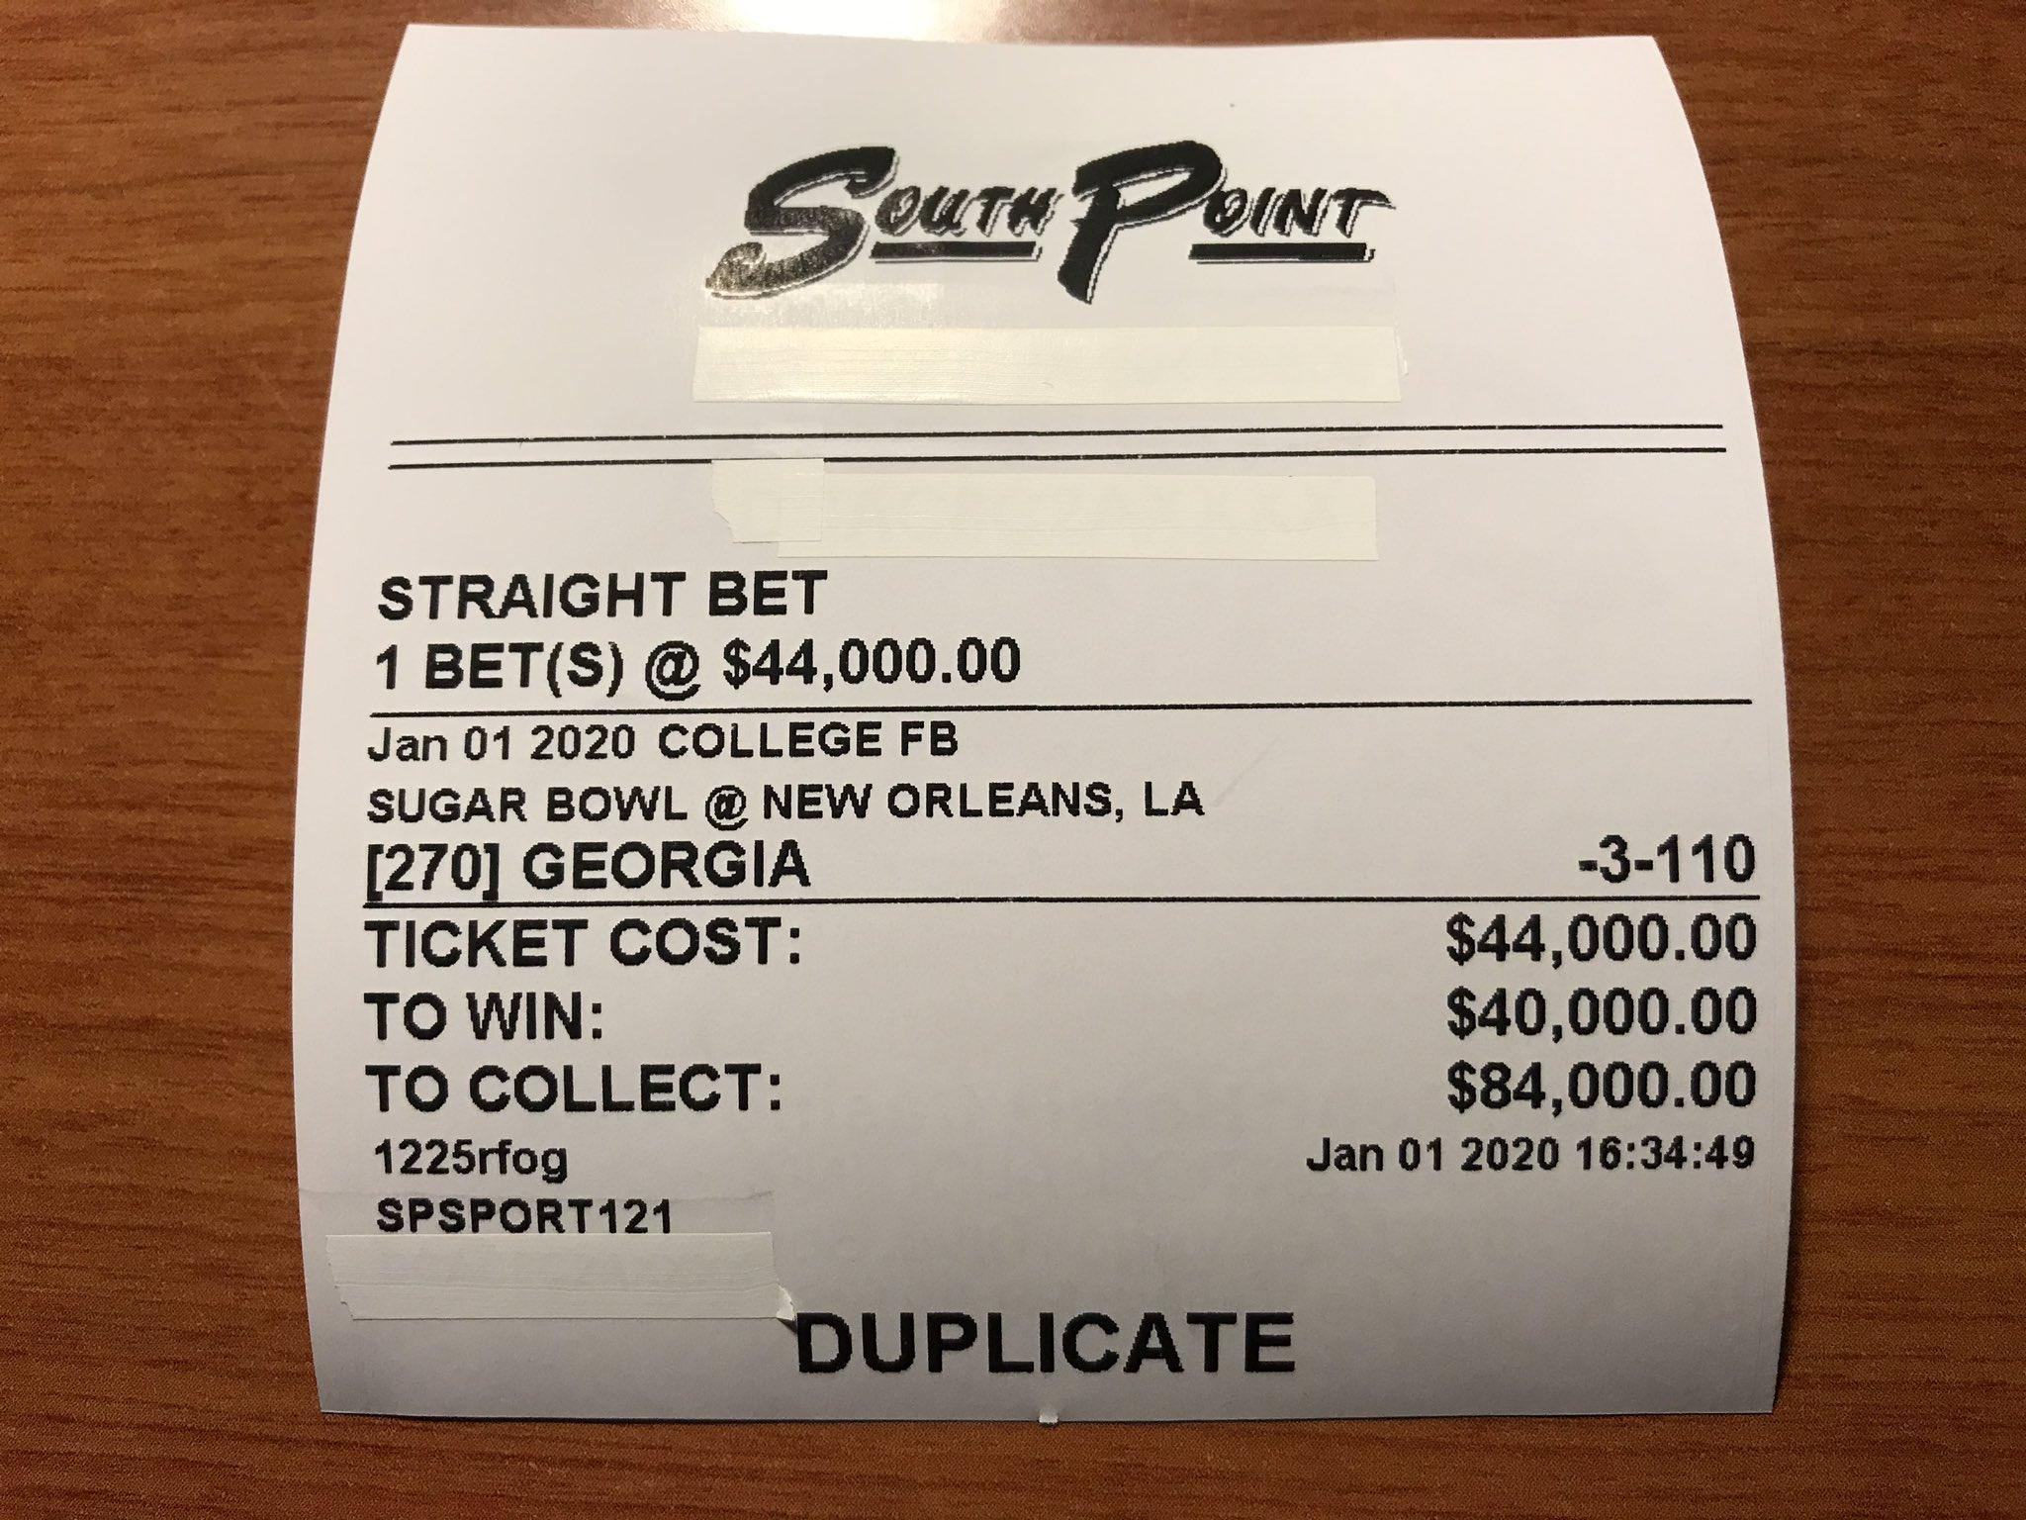
WHO CARES?
twitter@JimmyVaccaro
Notes:
Now you might be asking who cares? These are folks wagering $77k & $190k on the recent Superbowl; except, this ticket on the right that took on a greater risk, WON. these folks can be professional gamblers, a corporate executive who saved up his/her life savings, making life-changing decisions----im just hoping at the very least with the guidance of data.

Slide 7
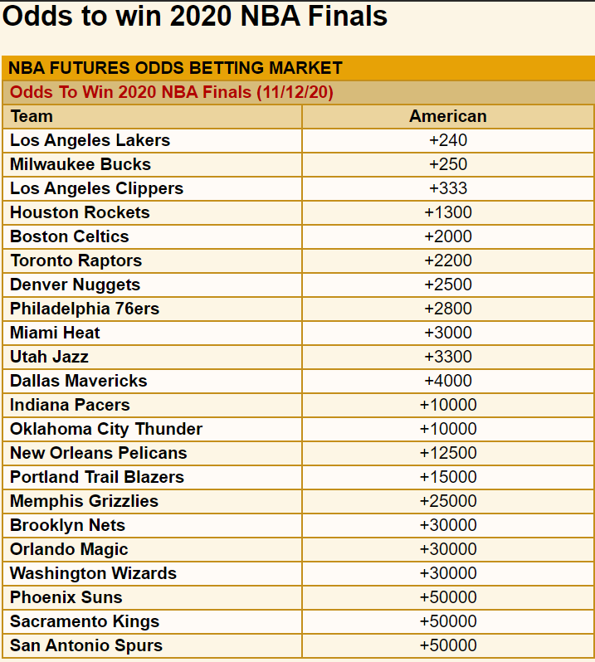
Team: | To Bet: | To Win:
Lakers +240 | $100 | $240
Bucks +250 | $100 | $250
Rockets +1300 | $100 | $1,300
Pelicans +12500 | $100 | $12,500
VegasInsider.com/nba/odds/futures
Notes:
So if you happen to be in a position to have what’s called “disposable income” in the gaming industry, AND you want to make some life-changing financial decisions & quickly: if you bet on the Lakers, who are the current favorites to win the championship, you get $240 for every $100 you bet, making it almost a 2 and a half X investment

Slide 8
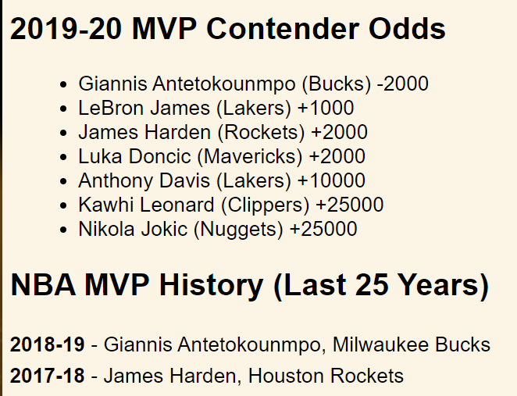
MVP: | To Bet: | To Win:
Giannis -2000 | $100 | $5
Lebron +1000 | $100 | $1,000
Luka +2000 | $100 | $2,000
Kawhi +25000 | $100 | $25,000
VegasInsider.com/nba/odds/futures
Notes:
The casino betting odds can also tell you who they think will win the MVP trophy, if you bet $100 on Giannis, you only win $5 because he is widely projected to be this season’s MVP. (he was also last year’s winner) VERSUS if you bet on lebron james to be the MVP this year, you 10x your investment.

Slide 9

PREDICTIONS
Who will win the 2020 NBA MVP?
(is Lebron James a decent bet?)
Which team will win the 2020 NBA championship?
(who will win between Lakers & Bucks)
Notes:
Which team will win the 2020 nba championship

Slide 10
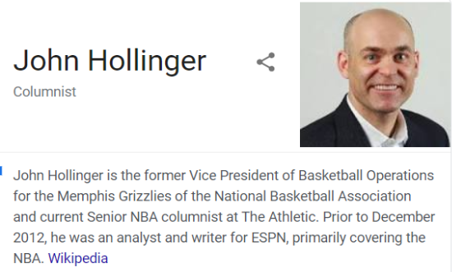

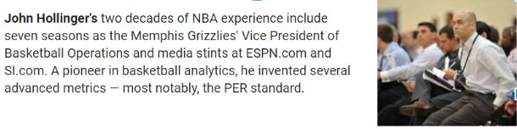
Notes:
John Hollinger is a veteran in the world of nba operation & analytics. He invented SEVERAL advanced metrics, MOST notably, the PER standard.

Slide 11
What is PER?
In John Hollinger's words, "The PER sums up all
player's positive accomplishments,
subtracts the negative attributes,
and returns a per-minute player performance rating.”
Positives [ FGM + Steals + 3PTM + FTM + Blocks + Rebounds + Assists ]
- Negatives [ Foul, MISS FT, MISS FG, TurnOver] *(1/Minutes)
ESPN/What is PER

Slide 12
Sources
https://github.com/swar/nba_api - s/o to “swar” & NBA.com
“An API Client package to access the APIs for NBA.com” from Github
https://www.kaggle.com/kerneler/starter-nba-player-hollinger-s-stats-d5131204-a - s/o to John Hollinger & ESPN
“2002-2018 Hollinger Table with metrics like PER, VA, & EWA” from Kaggle
https://www.youtube.com/watch?v=irjTWNV0eAY
https://www.youtube.com/watch?v=NCyPY-jfb3I- s/o to Ken Jee
“How to scrape NBA data & simulate games with Python” from Youtube

Slide 13
Sources pt.2
PER values for every player
PER & Simulation
2002-2018 Hollinger’s Table 2019 - 2020
1990
Present
NBA API
basic game stats needed for PER calculation

Slide 14
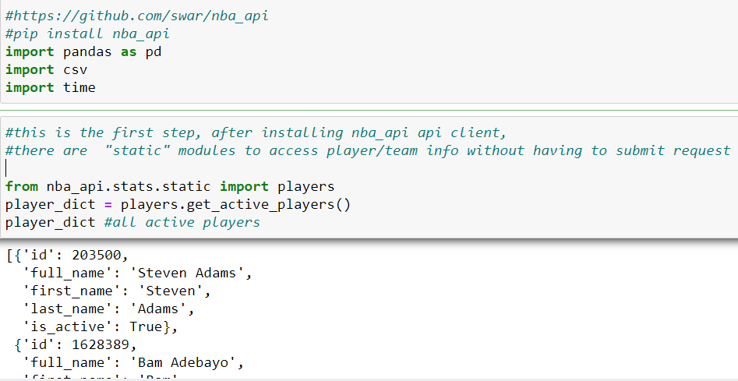
Exploration
Pip install nba_api
import players
get_active_players()

Slide 15
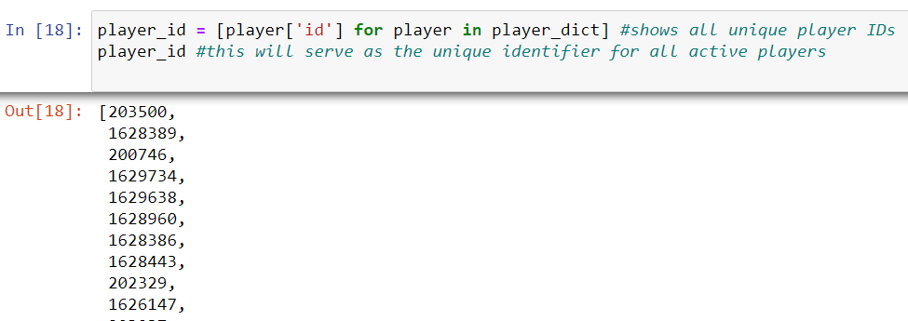
Exploration pt.2
loop player_dictionary
player_id

Slide 16
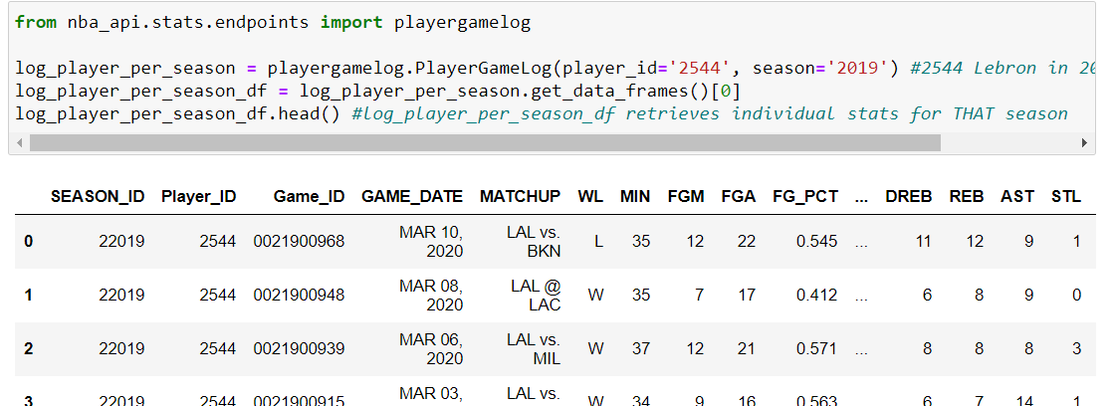
Exploration pt.3
PlayerGameLog endpoint

Slide 17
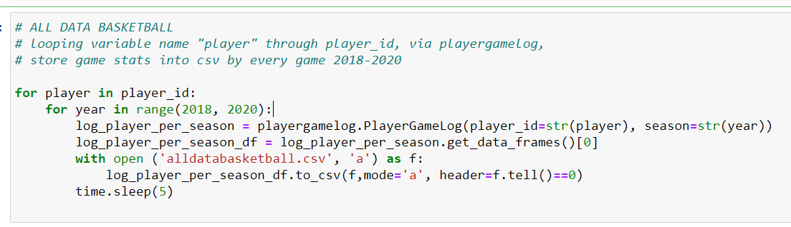
Exploration pt.4
time.sleep (5) seconds
Nested For loop
Notes:
What is the mode and f.tell doing?

Slide 18

Cleaning
Notes:
What is the mode and f.tell doing?

Slide 19
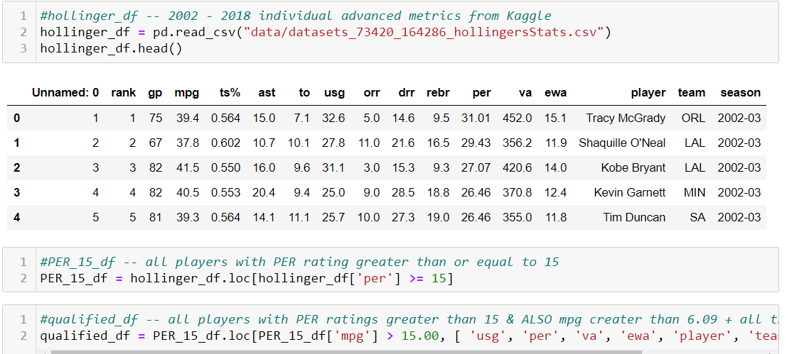
ALL PERs for ALL players 2002-2018
Notes:
What is the mode and f.tell doing?

Slide 20
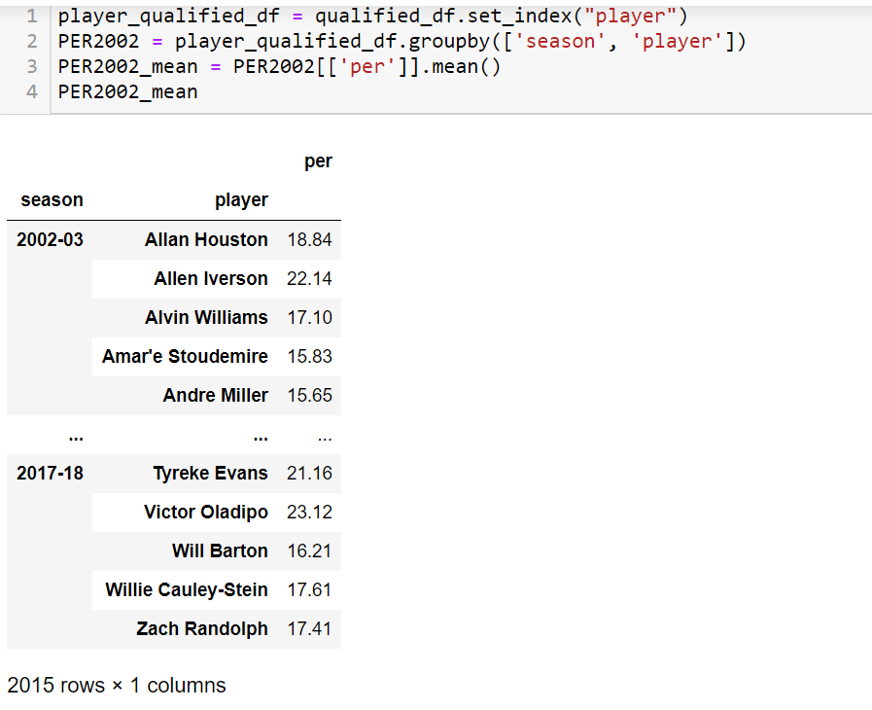
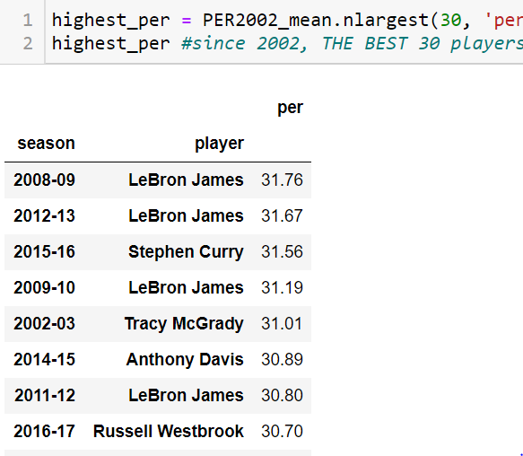
Hollinger
2002-2018
The 30 club

Slide 21
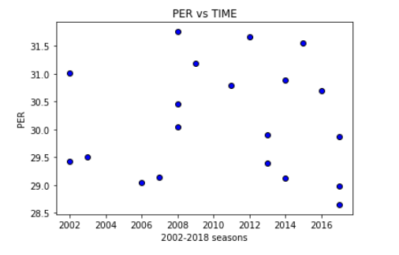
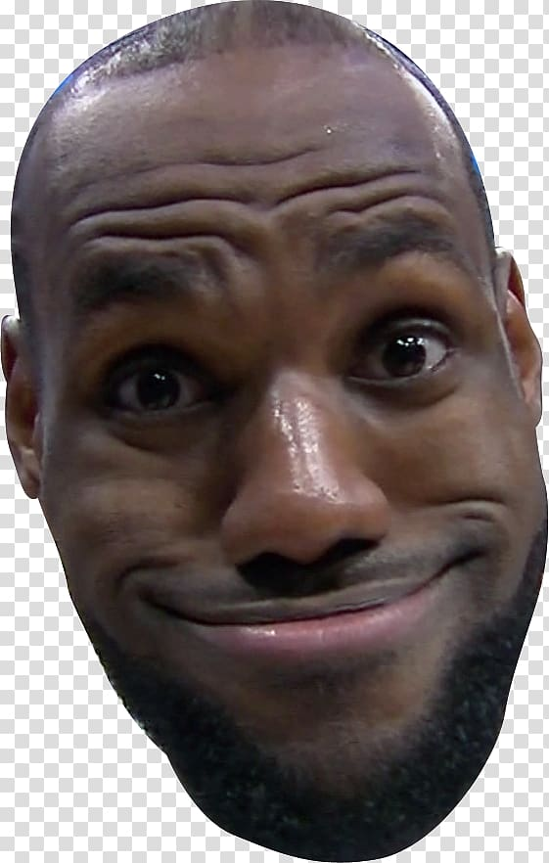

Slide 22
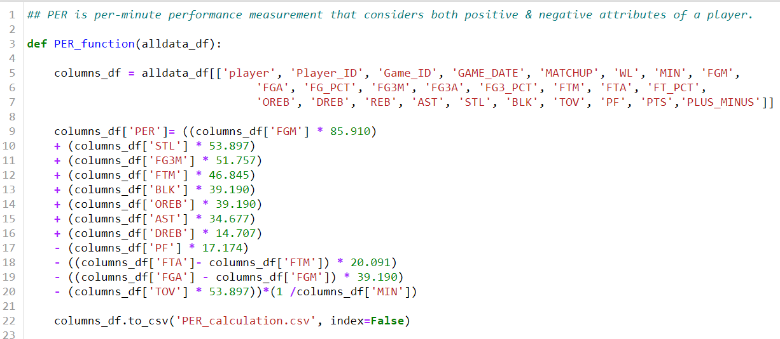
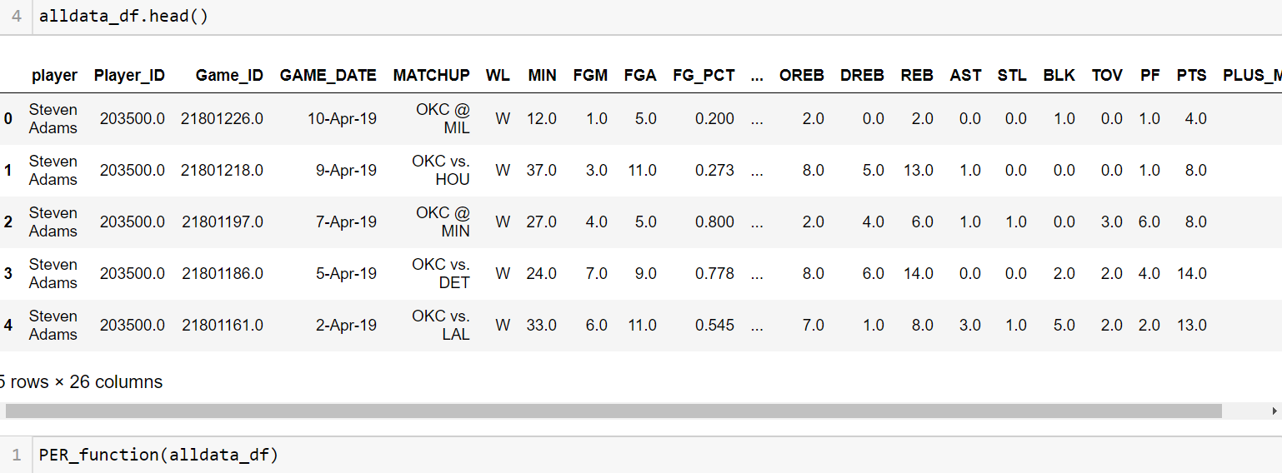

Slide 23
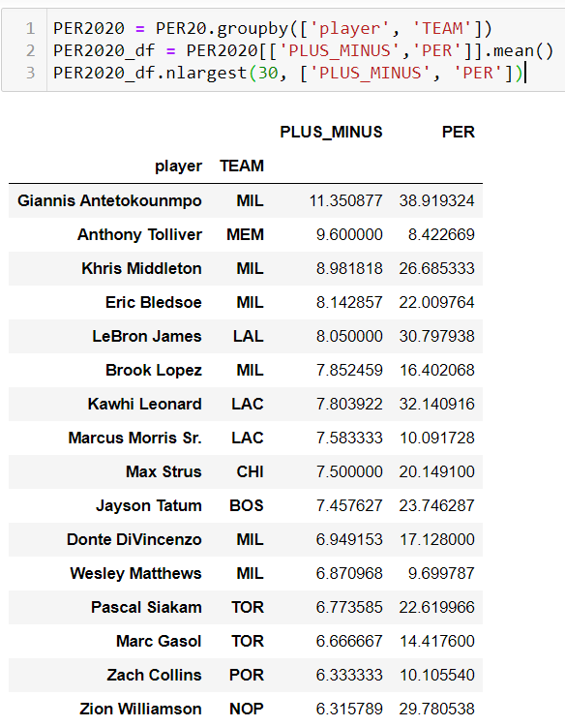
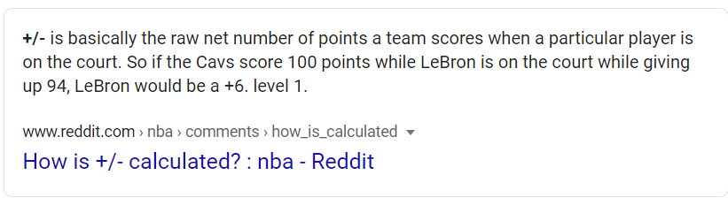
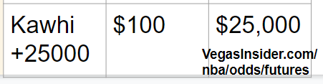
NBA API

Slide 24
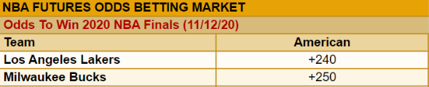
What’s a Simulation?!
“Randomly sampling from a distribution” - by itself it actually doesn’t mean a lot.
BUT, one team’s random distribution vs another in the same category, gives us some valuable insights - in our case we are doing points scored.

Slide 25
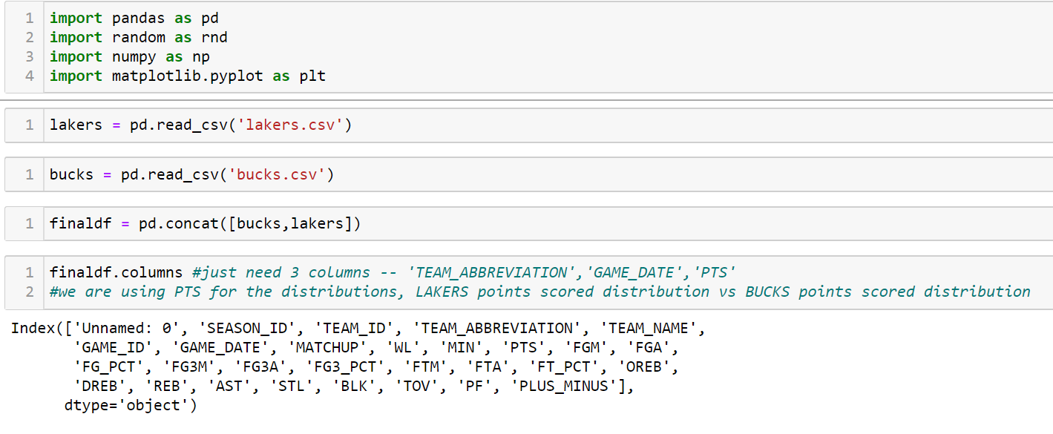

Slide 26
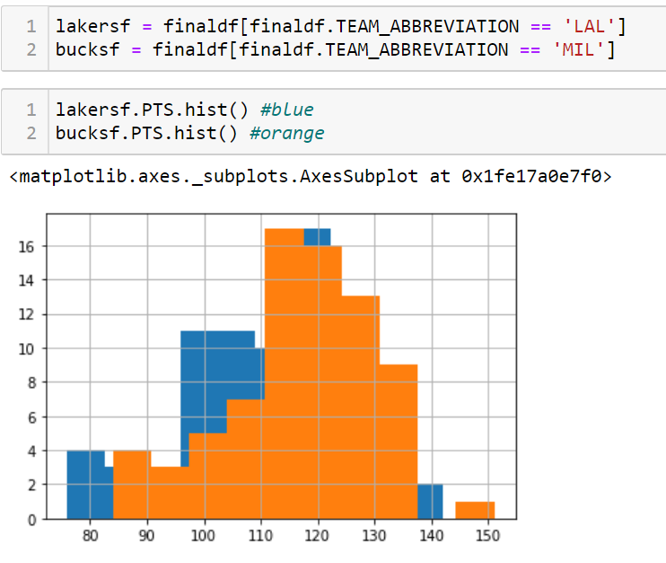

Slide 27
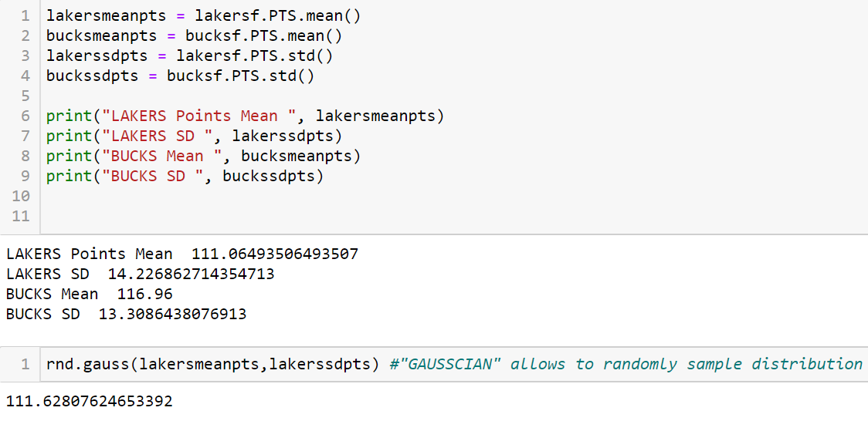

Slide 28
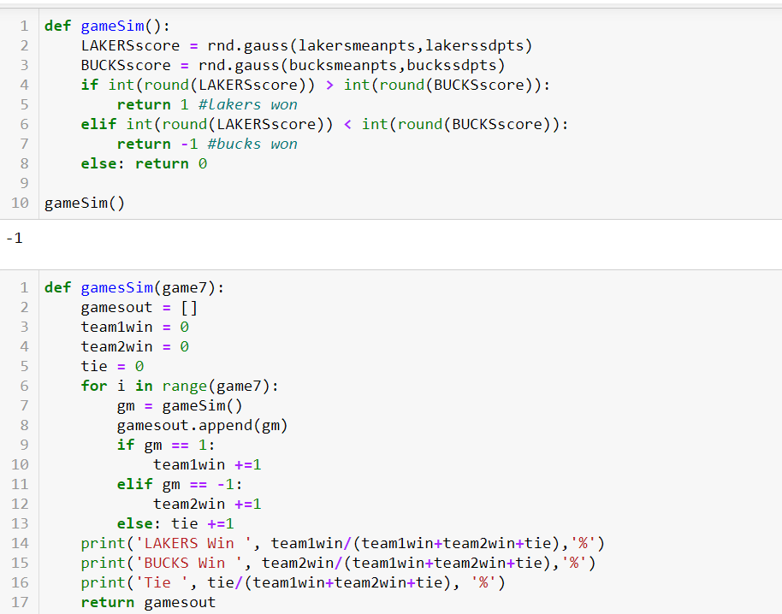

Slide 29
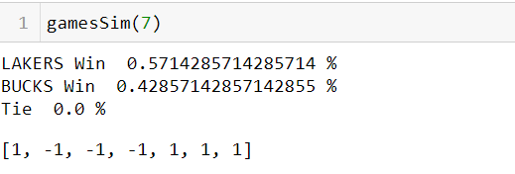

Slide 30
Summary
MVP Prediction: Lebron (+1,000) & Kawhi (+25,000)
Championship Prediction: Lakers (+240)
With more time:
Pull more data
More functions for advanced metrics
More distribution comparison

Slide 31
THANK YOU :)
And hopefully you win some money

